Slide 1

FIFA 19 Player Analysis
Project Group : 9
Group Members :
Nikhil Kashid
Akhilesh Kashyap

Slide 2
Use cases
Club manager provides a set of player data, Predictive model is able to forecast how good a football player is based on their game statistics like position, goals, appearances, etc.

Slide 3

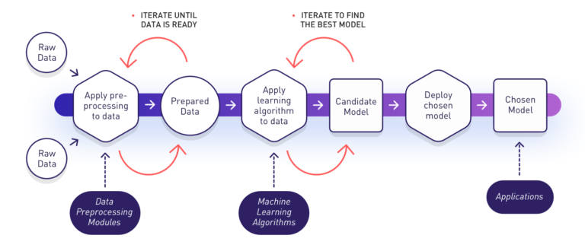
Methodology
Cleaning dataset
Fitting / Training the dataset to the model
Making predictions based on the fitted model
Save predictions and test the accuracy of the model
Predictions

Slide 4


Data Source
https://www.kaggle.com/karangadiya/fifa19
~ 20,000 rows
90 attributes

Slide 5

Milestones
Week 1
Cleaning / Preprocessing
Week 2
Implementing prediction model using Mllib
Apply ML on train dataset
Week 3
Prepare the candidate model
Iterate until data is ready
Iterate until model is ready
Deploy the chosen model on test data
Week 4
Implementing prediction model using Mllib
Apply ML algorithm to data
Week 5
Predictions
Final presentation

Slide 6
Tools Used
All Scala!

Slide 7
Acceptance Criteria
Players’ predicted error rate should be below 10%
There should be 0 null/blank data

Slide 8

https://github.com/akhileshkkr/csye7200Spring2019

Slide 9
Thank You

